Slide 1
Today in LSS
Introduction to the Closed Memo
Communicating Legal Analysis in Writing – IRAC & CREAC
Fox/Mustafa/Sobin
Yoncé Law Group Presentations
Bluebook Citations – Case Names

Slide 2
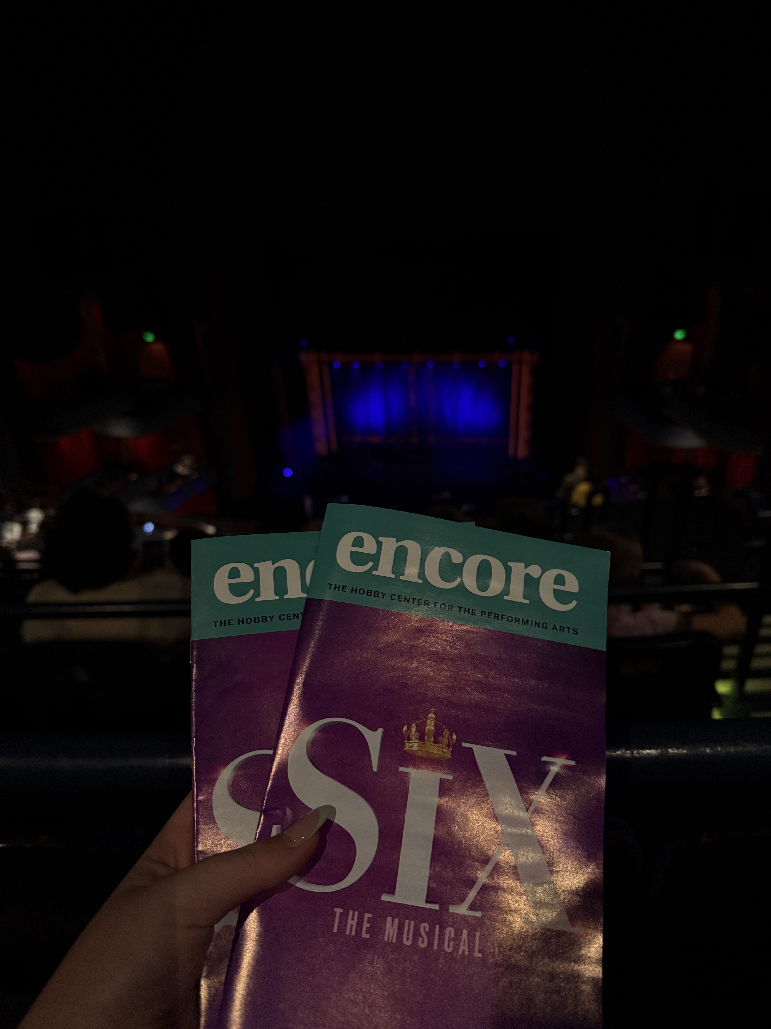
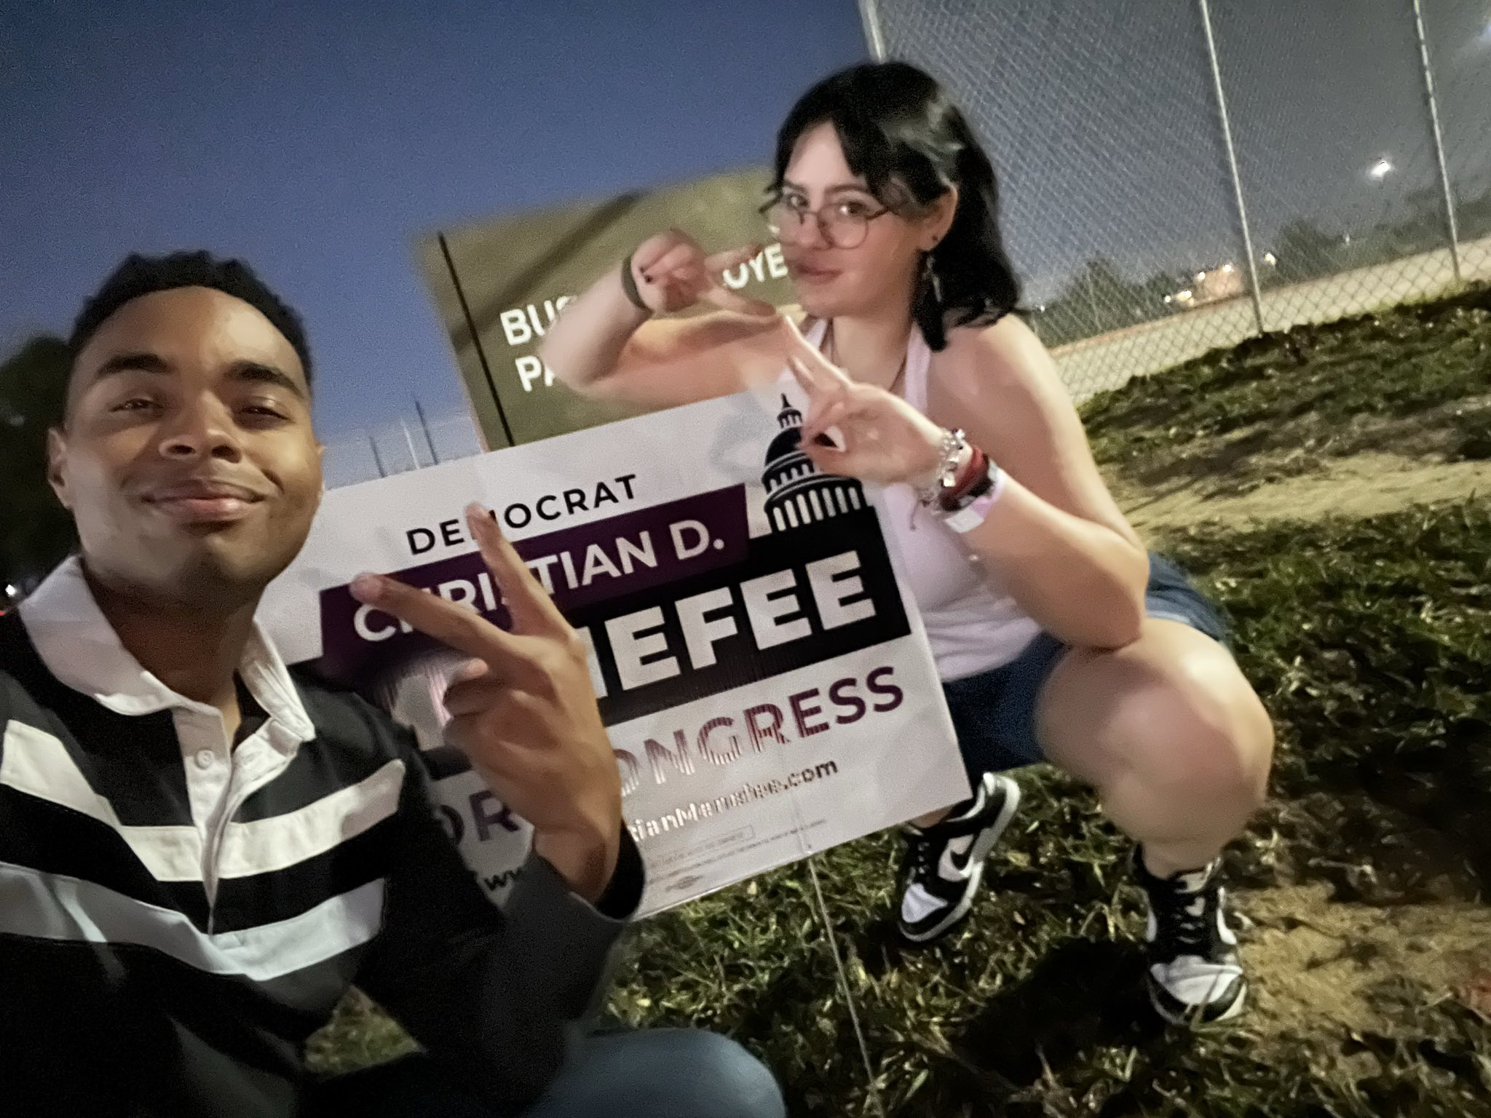


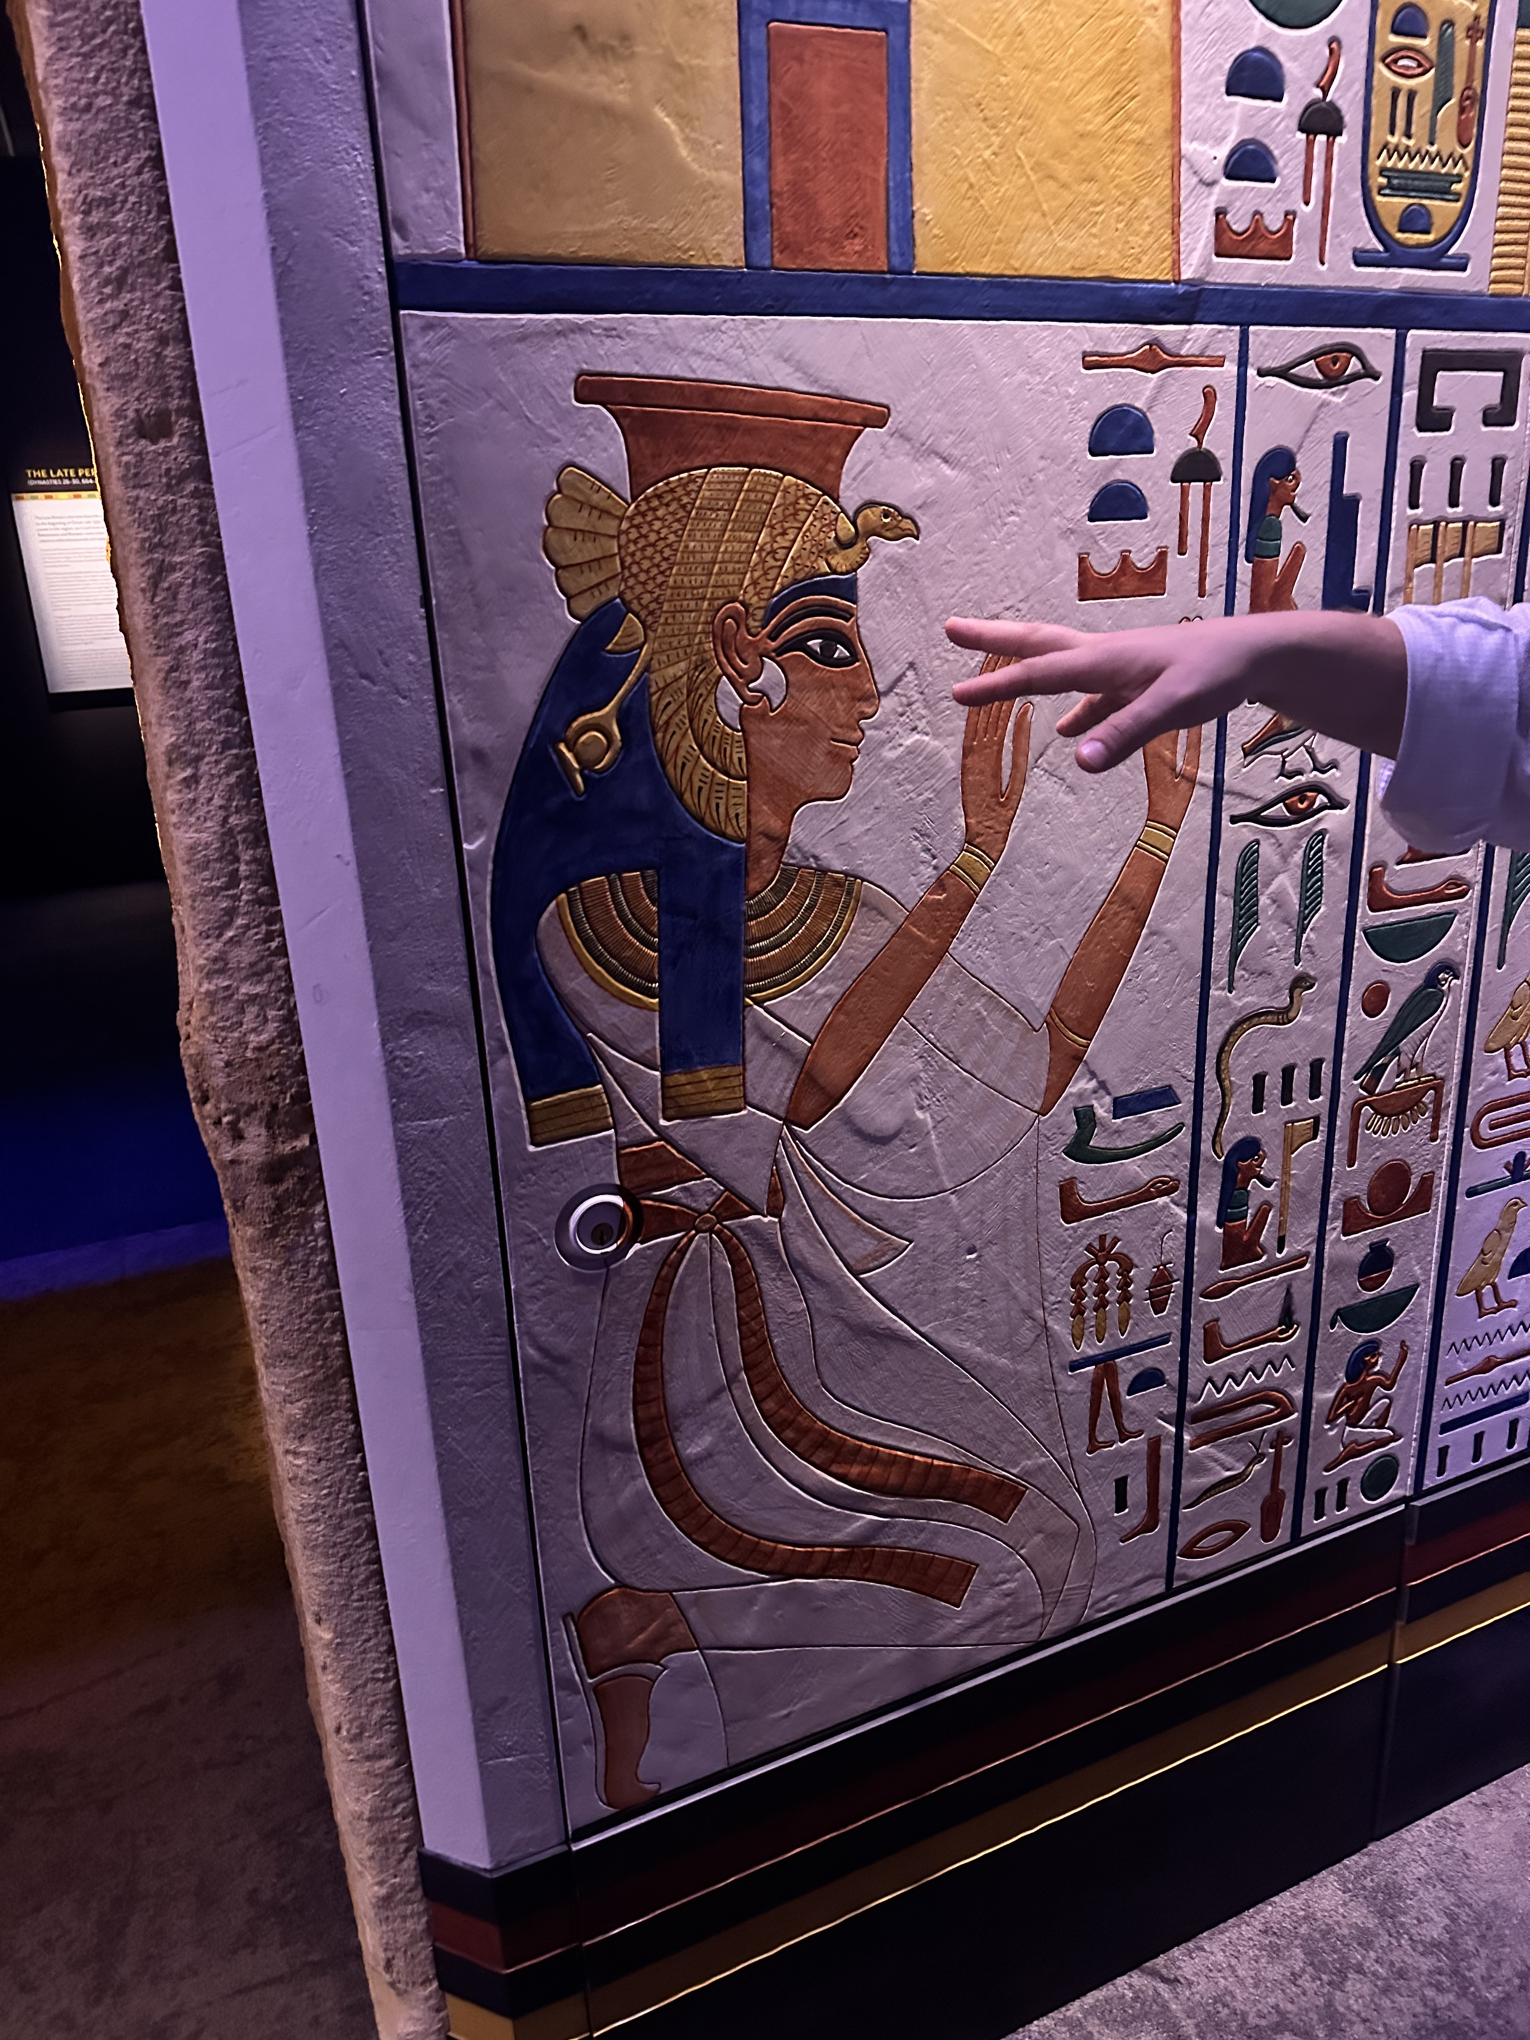
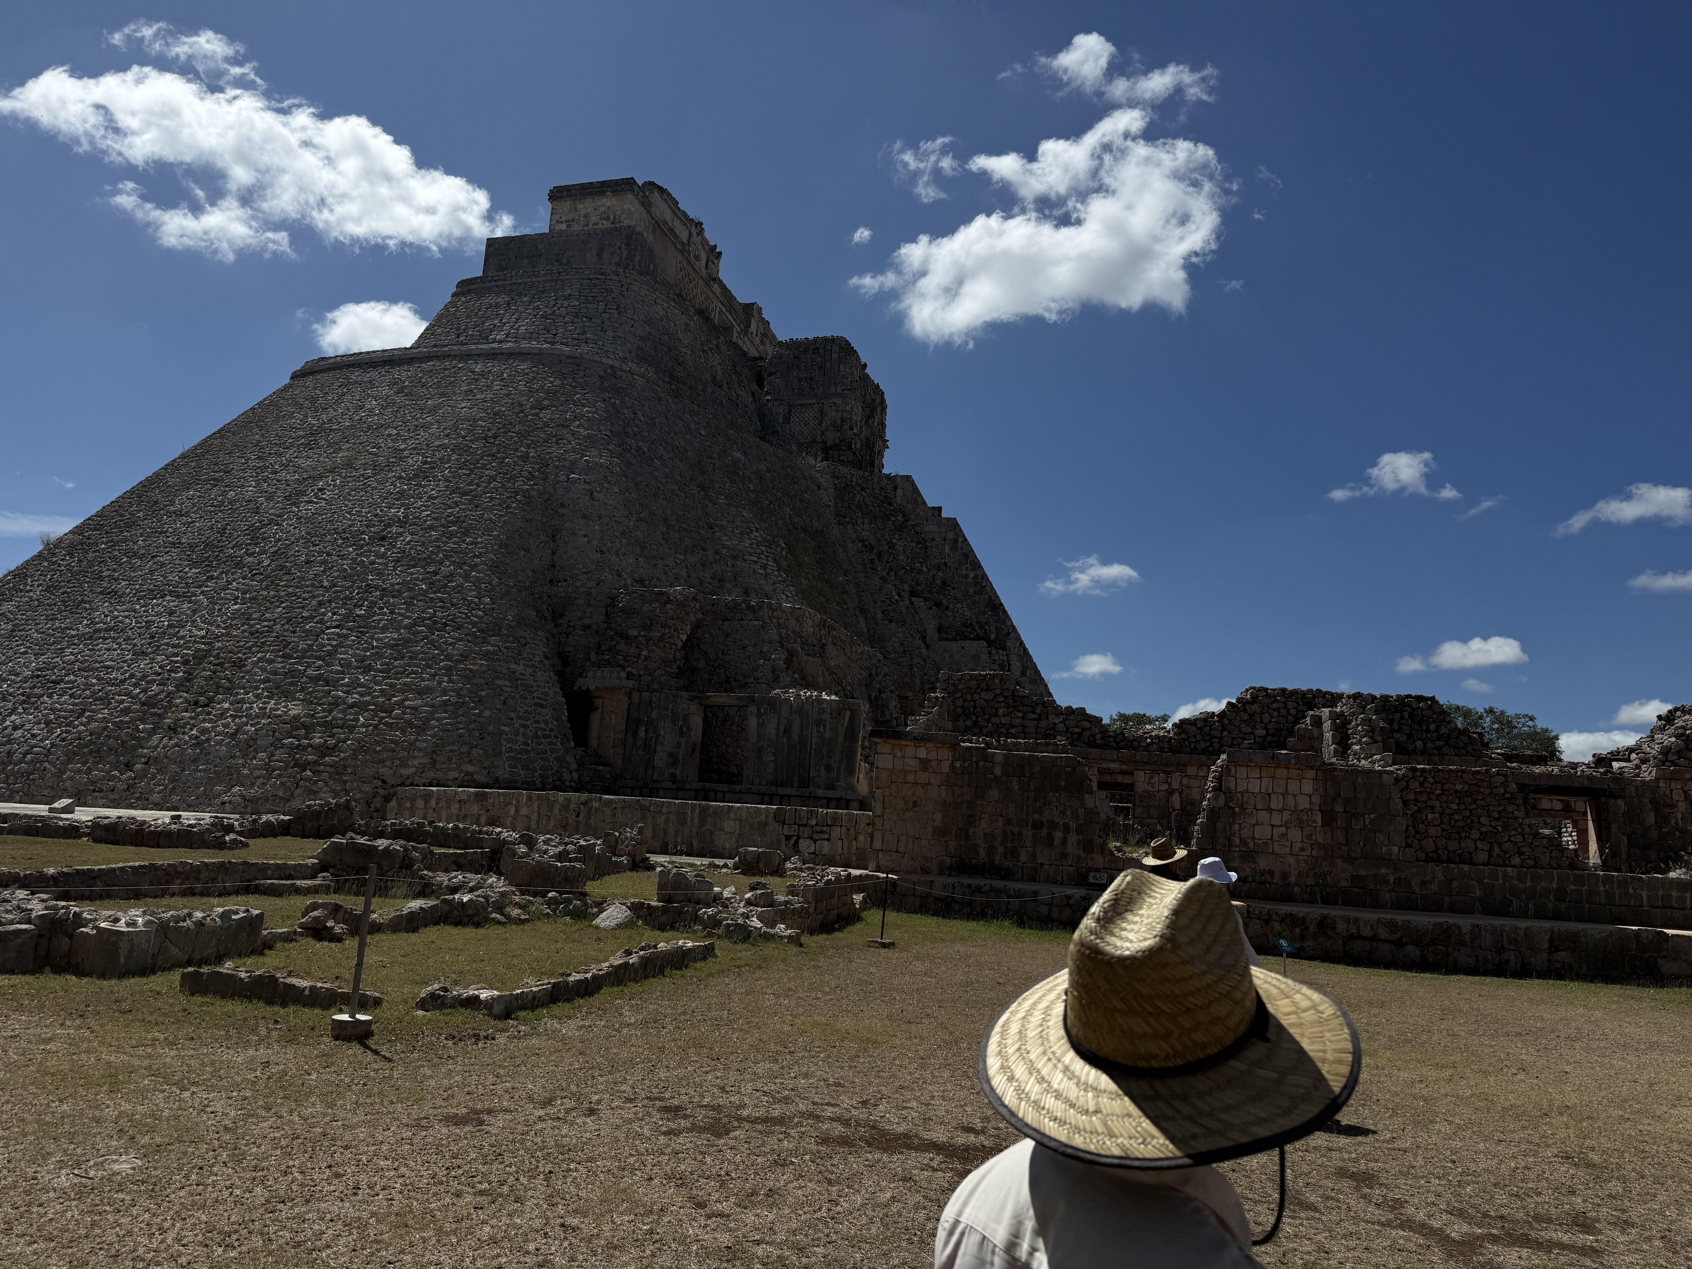
Sadie Bostwick
Musical theater.
Egyptology.
Sleepy, always.
Travel.
Mom & Sis.
POLITICS! Poli sci degree in practice, not just on paper.

Slide 3

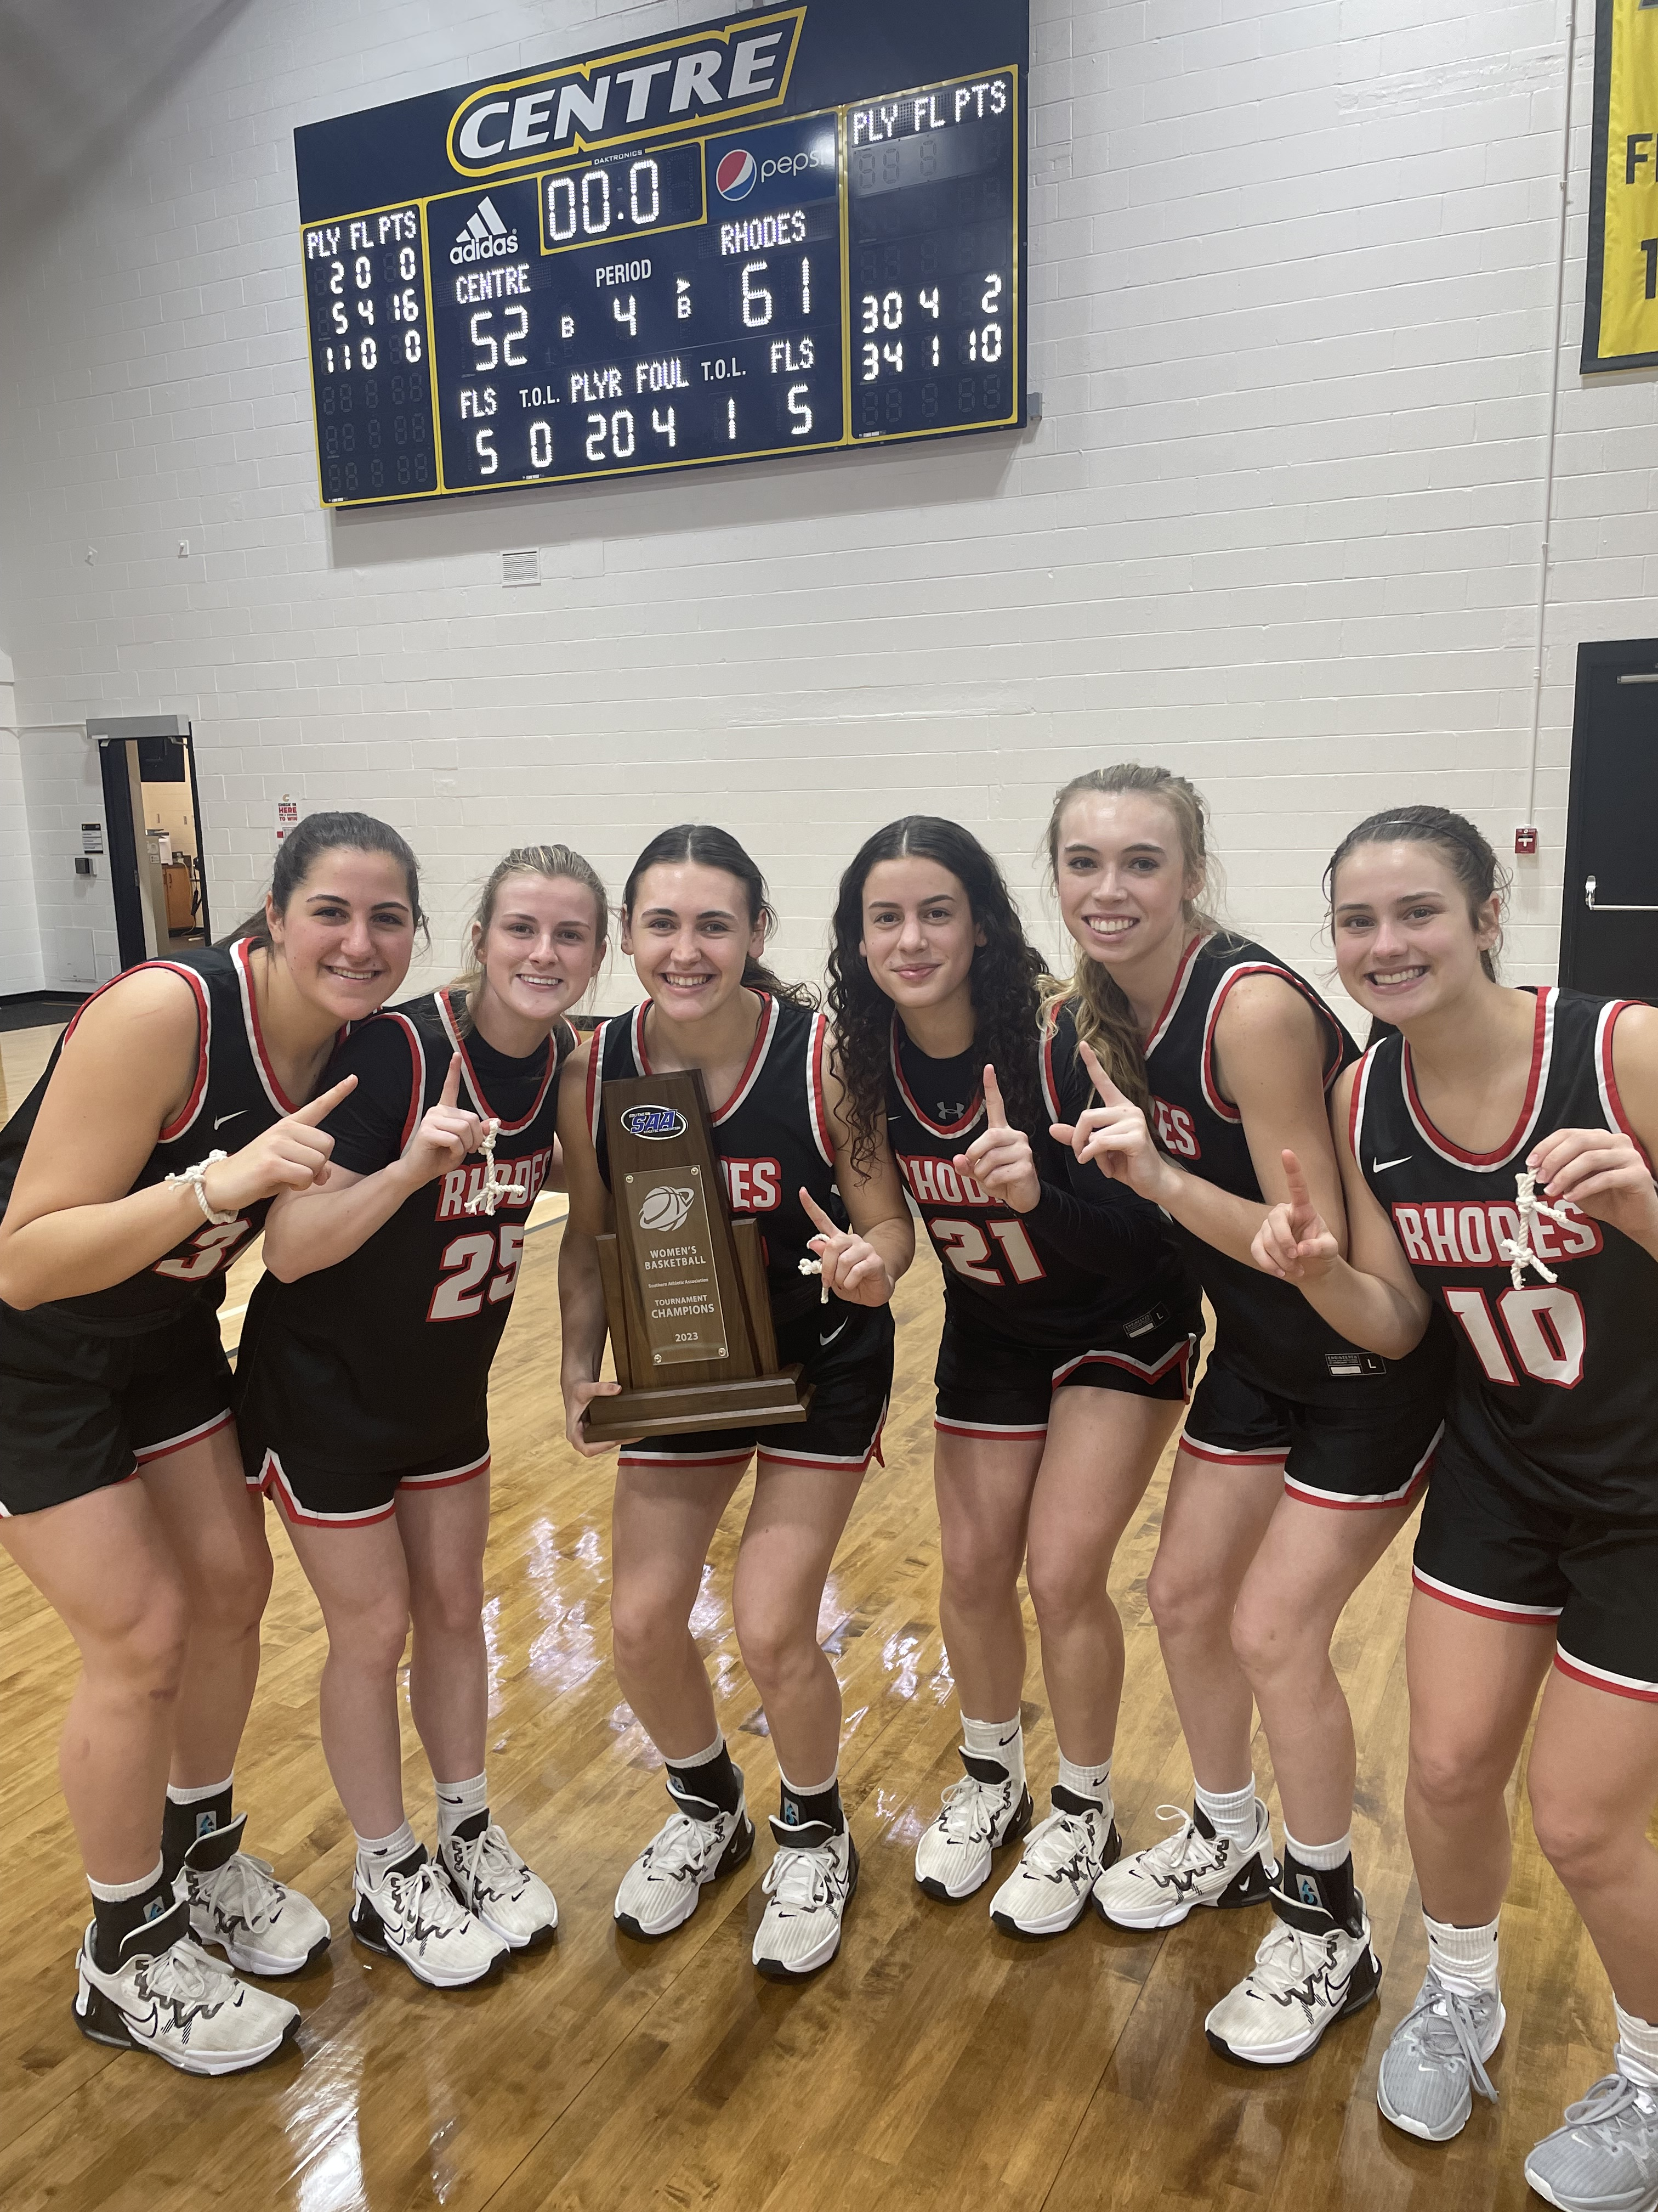
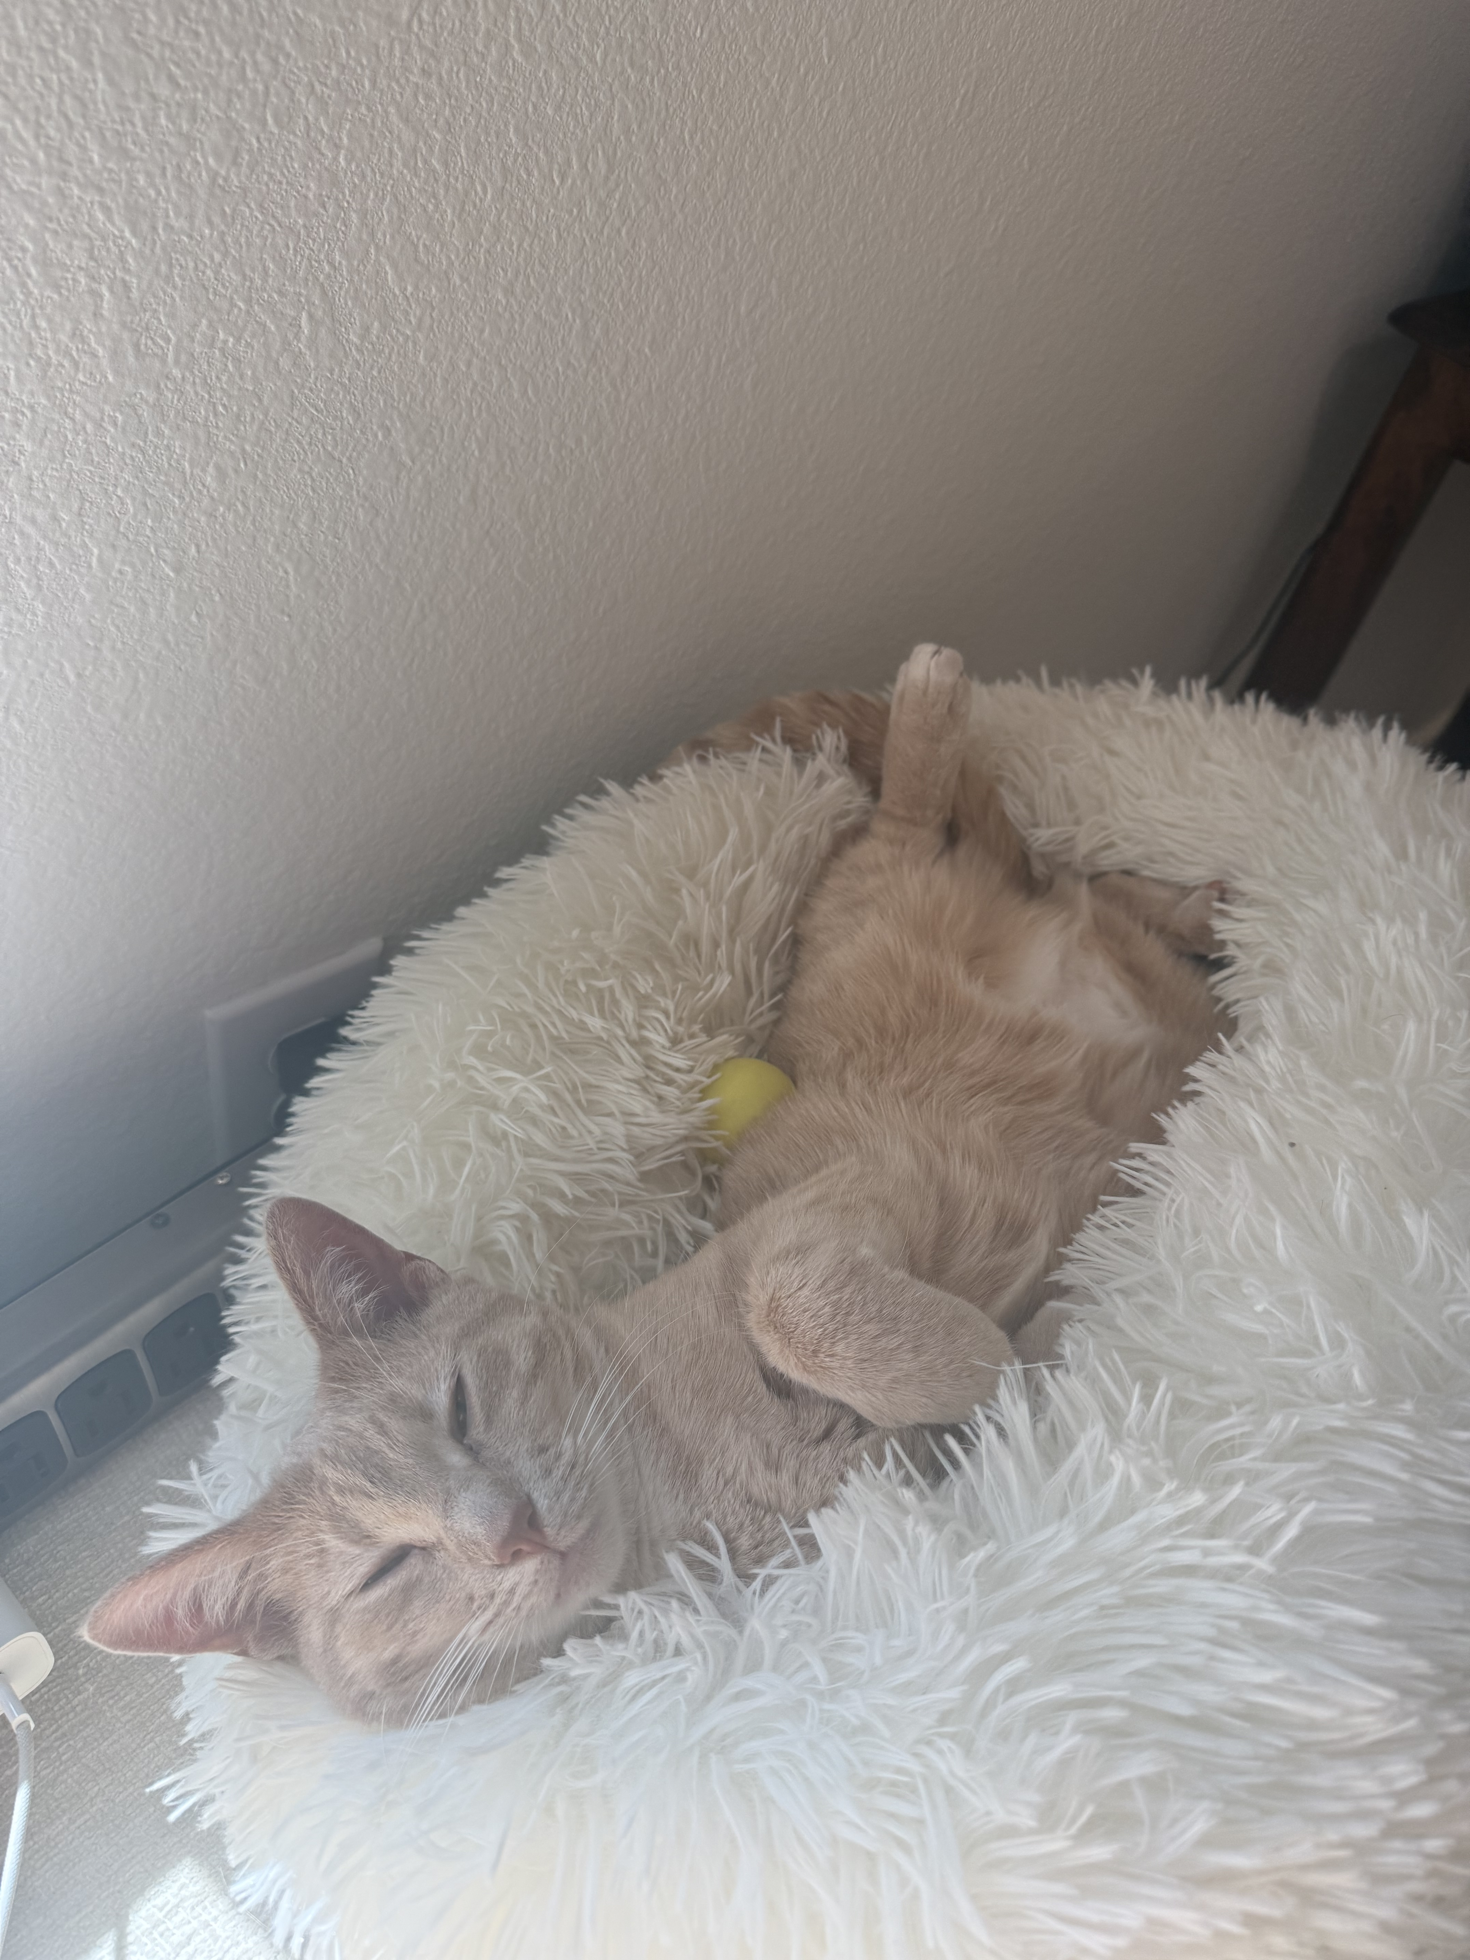
Audrey Griffith

Slide 4
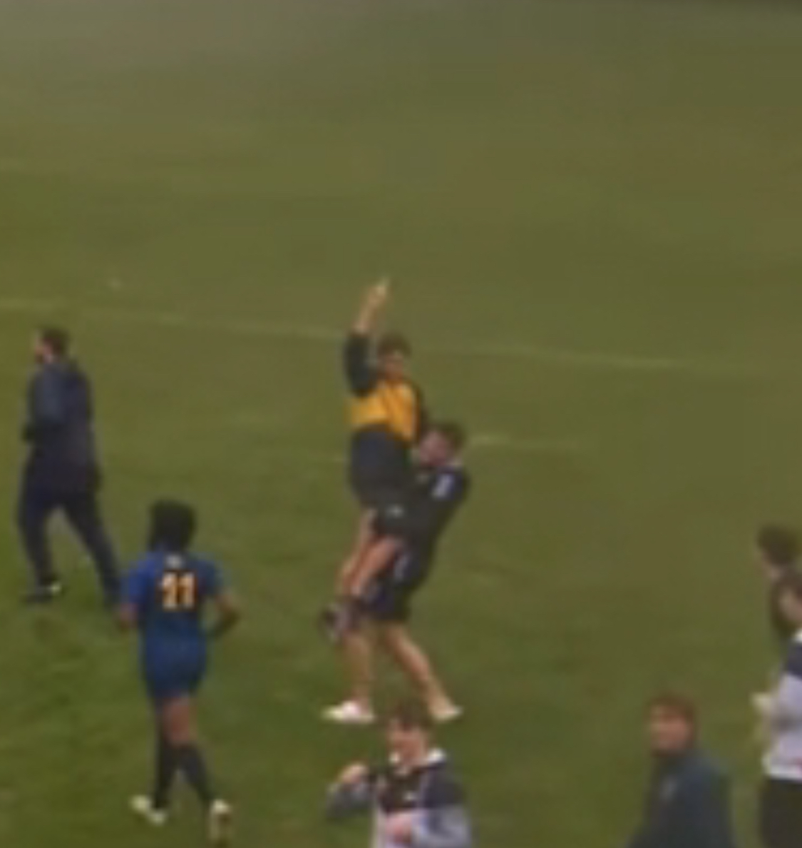
Conor McNabnay

Slide 5

Lilly Sills

Slide 6

Bluebook Citations – Intro. & Case Names

Slide 7
Parts of a Case Citation – Case Name
Southern Pacific Co. v. Jensen, 244 U.S. 205 (1917)
Case Name (the parties)
Childress v. Johnson, 103 F.3d 1221 (5th Cir. 1997)
Case Name (the parties)
Notes:
Almost always the names of the parties, separated by a v. Use italics.
Don’t italicize the comma at the end of the case name! Do italicize any punctuation within the case name.

Slide 8

How to Cite Case Names
Rules governing case names are listed in R10.2.1, R10.2.2, B2, B10.1.1.
Tables 6 and 10 and very important for case names. Flag them.
How we cite case names changes based on where the citation is within the text:
  A textual sentence; or
  A citation sentence.
Notes:
Welcome!

Slide 9
Textual v. Citation Sentences
Childress does not contend that he was entirely without an attorney during his 1946 and 1948 plea hearings, nor that counsel’s performance was ineffective within the meaning of Strickland v. Washington, 466 U.S. 668 (1984). He claims instead that he received no meaningful assistance at all from his court-appointed lawyer, and thus was constructively denied his Sixth Amendment right to counsel. See United States v. Cronic, 466 U.S. 648 (1984).
Notes:
Welcome!

Slide 10
Textual v. Citation Sentences
Childress does not contend that he was entirely without an attorney during his 1946 and 1948 plea hearings, nor that counsel’s performance was ineffective within the meaning of Strickland v. Washington, 466 U.S. 668 (1984). He claims instead that he received no meaningful assistance at all from his court-appointed lawyer, and thus was constructively denied his Sixth Amendment right to counsel. See United States v. Cronic, 466 U.S. 648 (1984).
The citation to Strickland v. Washington is part of a textual sentence, meaning that the case citation is part of a full, grammatical sentence.
Notes:
Welcome!

Slide 11
Textual v. Citation Sentences
Childress does not contend that he was entirely without an attorney during his 1946 and 1948 plea hearings, nor that counsel’s performance was ineffective within the meaning of Strickland v. Washington, 466 U.S. 668 (1984). He claims instead that he received no meaningful assistance at all from his court-appointed lawyer, and thus was constructively denied his Sixth Amendment right to counsel. See United States v. Cronic, 466 U.S. 648 (1984).
The citation to Strickland v. Washington is part of a textual sentence, meaning that the case citation is part of a full, grammatical sentence.
The citation to United States v. Cronic is part of a citation sentence, meaning that it is not a full grammatical sentence. The only purpose of the “sentence” is to include citations.
Notes:
Welcome!

Slide 12

Case Names
Notes:
Welcome!

Slide 13
Case Names
Who are the parties?
  Are there more than one party on each side of the v.?
    If yes: omit all parties other than the first listed on each side. R10.2.1(a).
    See special rules for relators, partnerships, and procedural phrases (e.g., “in the matter of”). R10.2.1(a), (b).
    Omit “et al.,” and alternative names for a single party (like “d/b/a”). R10.2.1(a).
Notes:
Welcome!

Slide 14
    Homer Simpson, Marge Simpson, and Ned Flanders
    v.
    The Springfield Nuclear Electric Company, Inc.,
    C. Montgomery Burns and Waylon Smithers, et al.
Notes:
Welcome!

Slide 15
    Homer Simpson, Marge Simpson, and Ned Flanders
    v.
    The Springfield Nuclear Electric Company, Inc.,
    C. Montgomery Burns and Waylon Smithers, et al.
Notes:
Welcome!

Slide 16
    Homer Simpson
    v.
    The Springfield Nuclear Electric Company, Inc.
Notes:
Welcome!

Slide 17
Case Names
Who are the parties?
  Is the first-named part on either side of the “v” an individual (not a company, government or entity)?
    If yes: omit the first name and only use the surname. R10.2.1(g).
    Omit descriptive terms like “administrator, appellee, executor.” R10.2.1(e).
Notes:
Welcome!

Slide 18
    Homer Simpson
    v.
    The Springfield Nuclear Electric Company, Inc.
Notes:
Welcome!

Slide 19
    Homer Simpson
    v.
    The Springfield Nuclear Electric Company, Inc.
Notes:
Welcome!

Slide 20
    Simpson
    v.
    The Springfield Nuclear Electric Company, Inc.
Notes:
Welcome!

Slide 21
Case Names
Who are the parties?
  Is the first-named party on either side of the “v” an entity or government?
    If yes: omit “The” at the start of a party name. R10.2.1(d).
    Omit “Inc., “Ltd.,” “L.L.C.,” “N.A.,” “F.S.B.,” and similar terms if the entity name also contains a word such as “Ass’n,” “Bros.,” “Co.,” “Corp., “Ins.,” or “R.R.” R10.2.1(h).
Notes:
Welcome!

Slide 22
    Simpson
    v.
    The Springfield Nuclear Electric Company, Inc.
Notes:
Welcome!

Slide 23
    Simpson
    v.
    The Springfield Nuclear Electric Company, Inc.
Notes:
Welcome!

Slide 24
    Simpson
    v.
    Springfield Nuclear Electric Company
Notes:
Welcome!

Slide 25
Case Names
Who are the parties?
  Will I need to abbreviate any words in the case name?
    Is the citation in a textual sentence or a citation sentence?
      If a textual sentence: follow R10.2.1(c) and abbreviate only:
        widely-known acronyms (R6.1(b)) and the words “&,” “Ass’n,” “Bros.,” “Co.,” “Corp.,” “Inc.,” “Ltd.,” and “No.”
      If a citation sentence:
        Abbreviate any words listed in T6 or geographical entities listed in T10 (unless the geographical entity is the entire name of the party). R10.2.2.
Notes:
Welcome!

Slide 26
    Simpson
    v.
    Springfield Nuclear Electric Company
Notes:
Welcome!

Slide 27
Textual sentence
    Simpson
    v.
    Springfield Nuclear Electric Co.mpany
Notes:
Welcome!

Slide 28
Textual sentence
    Simpson
    v.
    Springfield Nuclear Electric Co.
Notes:
Welcome!

Slide 29
    Simpson
    v.
    Springfield Nuclear Electric Company
Notes:
Welcome!

Slide 30
Citation sentence
    Simpson
    v.
    Springfield Nuclear Elec.tric Co.mpany
Notes:
Welcome!

Slide 31
Citation sentence
    Simpson
    v.
    Springfield Nuclear Elec. Co.
Notes:
Welcome!

Slide 32
    Homer Simpson, Marge Simpson, and Ned Flanders
    v.
    The Springfield Nuclear Electric Company, Inc.,
    C. Montgomery Burns and Waylon Smithers, et al.
Notes:
Welcome!

Slide 33
    Abbreviations:
    Always check T6 & T10!
Notes:
Welcome!

Slide 34
Case Names
Who are the parties?
  Last step for case name: Italicize the party names, the “v.,” and any internal punction.
    DO NOT ITALICIZE THE COMMA WHICH FOLLOWS THE PARTY NAMES
Notes:
Welcome!

Slide 35
    Simpson v. Springfield Nuclear Elec. Co.,
Notes:
Welcome!

Slide 36
    Simpson v. Springfield Nuclear Elec. Co.,
NOT ITALICIZED
Notes:
Welcome!

Slide 37
Additional Resources
Interactive Citation Workstation
Bluebook Uncovered (free book on Canvas)
Legal Writing Center Fellows

Slide 38
Legal Memoranda Organization – Discussion Section

Slide 39
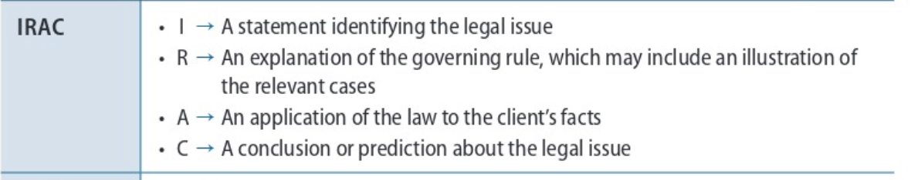
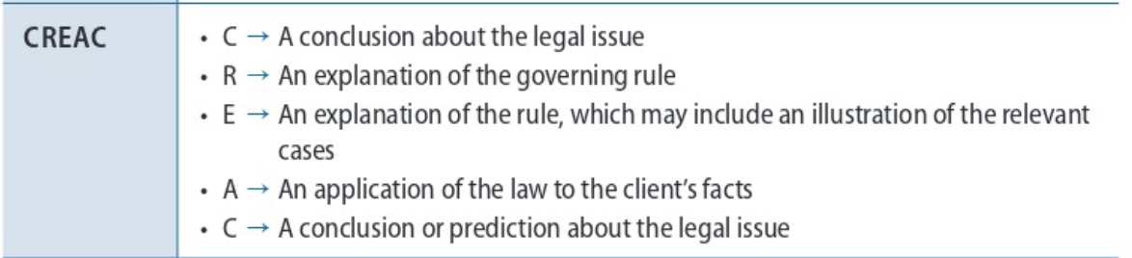
Different Legal Writing Paradigms

Slide 40
Written Legal Analysis Organization - Discussion Sections
Conclusion
Describes the problem you are presented with as an up-front prediction.
Explain comparable case(s) before distinguishing cases.
Rules
Summarizes the law – from general to specific – without reference to any facts.*Always written in present tense.*
(Case) Explanation
Starts with a thesis sentence. Provides facts, reasoning, and holding of prior case. *Always written in past tense*
Application
Compare/contrast facts and reasoning of prior cases with your facts using side-by-side comparisons.
*Discuss your client’s facts for the first time in the application paragraphs.
Conclusion
One sentence stating your overall conclusion/prediction.

Slide 41
Legal Memoranda
PURPOSE: Analyze a legal issue in an objective, neutral* manner.
GOAL: Predict how the legal issue would likely be resolved by a court.
*Look at all sides of the issue.
*Identify strengths AND weaknesses of your prediction.
Notes:
For the first 2 weeks we covered materials that are going to be ingredients in your final memo.
If the memo is your finished product, we were getting some of the components down-
Comparing and distinguishing facts, pulling out and analyzing rules, etc. We are going to keep doing those things- and in a memo it is the way that you are presenting this legal analysis.
Look at all sides of the issue—include all relevant law (cases, statutes, regulations) that support and do not support your position.

Slide 42
Memos: Who is Your Audience?
Memos are generally internal working documents, so your audience is likely:
Senior attorneys in your firm/organization
Judges (if you are an intern/clerk)
Sometimes the client
It is not a document submitted to a court.
Notes:
Look at all sides of the issue—include all relevant law (cases, statutes, regulations) that support and do not support your position.

Slide 43
Legal Memoranda
Memos are highly structured for ease of reading and predictability.
They contain, and judges and attorneys will EXPECT them to contain, the following sections:
Caption
Question Presented (a/k/a Issue Statement)
Brief Answer
Statement of Facts
Discussion (this is where the CReAC analysis goes)
Conclusion
Notes:
Later in class we will be looking at an example

Slide 44
Structure – Single Issue Memo
MEMORANDUM
TO:
FROM:
DATE:
RE:
__________________________________________________
QUESTION PRESENTED
BRIEF ANSWER
STATEMENT OF FACTS
DISCUSSION
CONCLUSION

Slide 45
BLW Sample Memo Exercise
Reread Sample Memo in BLW, page 11.
Get in your Law Firms
Yoncé Law Group – find the rule statement
Astro & Toro LLP – find the case explanations
Love, Price, Whitehurst, and Tran LLP – find the application section
River & Oaks – find the conclusion sections

Slide 46
Closed Memorandum – Discussion Section Assignment

Slide 47
Closed “Memo” Assignment
What are you being asked to do?
What is the legal issue?
When is it due and are there formatting requirements?
What steps should you take next?

Slide 48

Question: Do you have to write any section of the Closed Memo other than the Discussion?
No.

Slide 49
HINT: Do what we did in class for Mustafa and Sobin…
Chart the cases
Find the applicable rules (the standards, factors, etc. that guide courts faced with your legal issue).
Identify the legally significant facts.
Compare and contrast with our client’s facts.

Slide 50
Analysis of Fox’s Application
In CREAC form

Slide 51
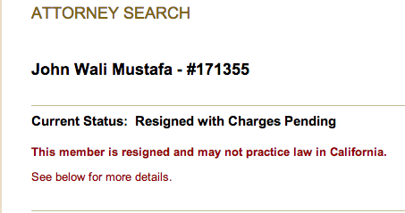
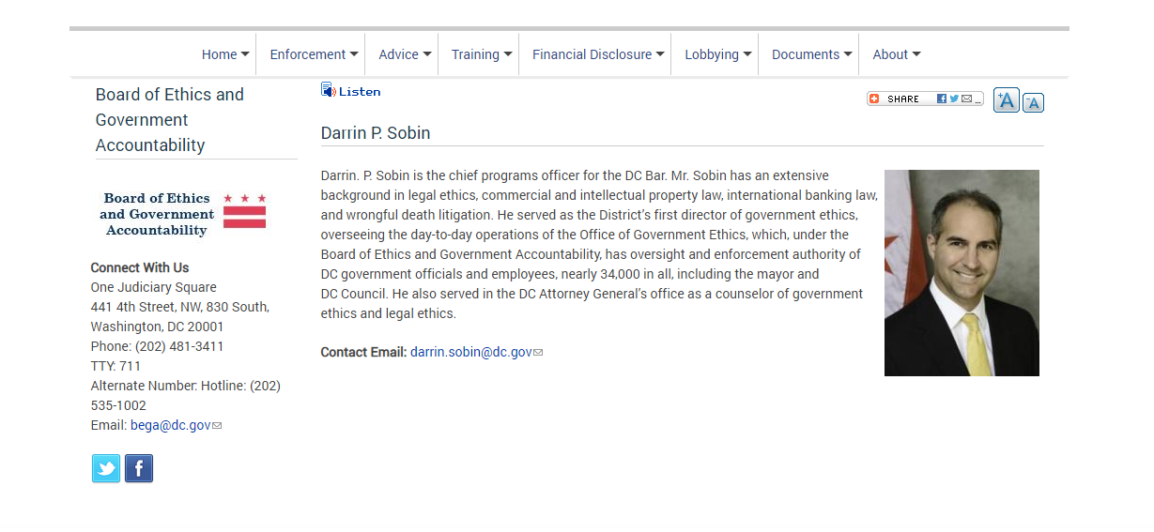
Where Are They Now?
Notes:
Mustafa: Admitted to CA after DC rejection. Resigned. Commingling funds; not answering calls.
Sobin: Director of Ethics, Board of Ethics and Government Accountability, Wash DC

Slide 52
For Tuesday
Read BLW Ch.4 (I-IV) pp. 85 – 88; Complete Exercises 4.1, 4.2, 4.4
Read, brief, and chart your cases for the Closed Memo Discussion Section and be prepared to discuss
ICW Citing Exercises 1 & 2 (read modified instruction in Week 2 Module) due 5 PM on Sunday, 9/6 – extra office hours for citations - Friday 2 PM-3 PM on Zoom
Complete Legal Research Modules 1.1 – 1.3 by 5 PM
Love, Price, Whitehurst, and Tran LLP send me your image PowerPoint slide by Monday at 2 PM

